Slide 1
Chemical Manufacturing Analysis
By: Brandon Boyle

Slide 2
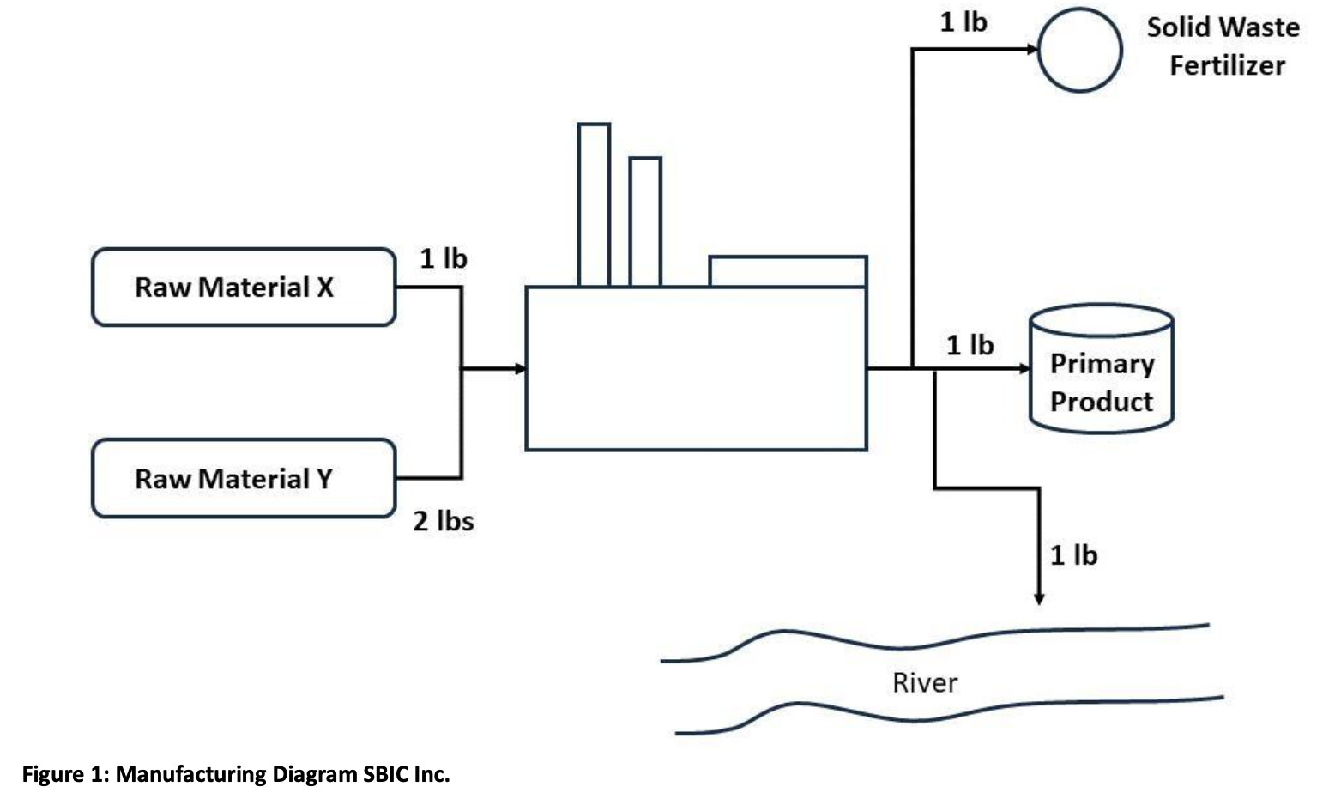
Background
Chemical manufacturing company looking to maximize profit and handle waste

Slide 3
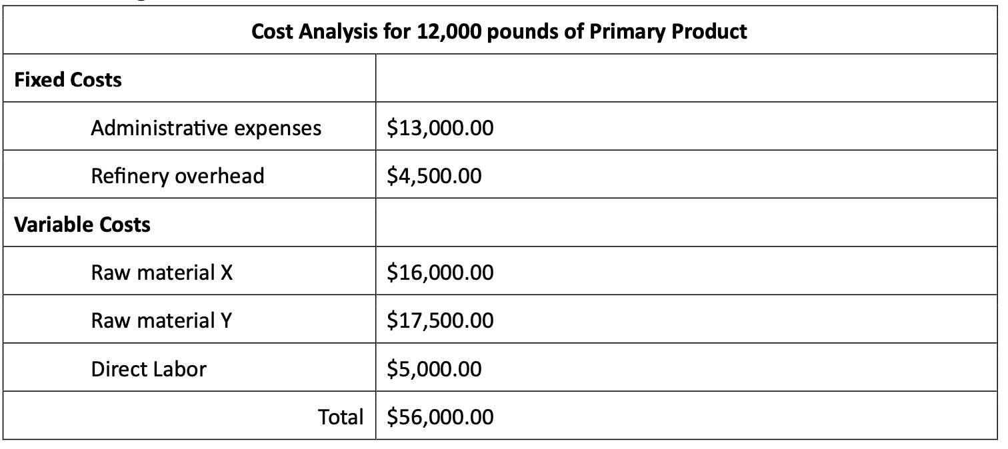
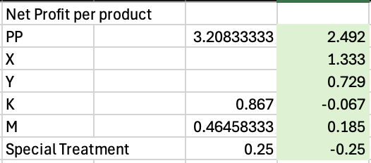
Cost Analysis

Slide 4
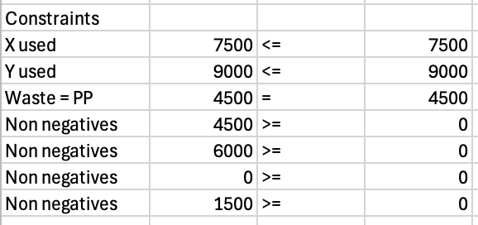
Constraints

Slide 5
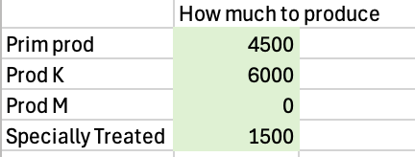

Solution

Slide 6
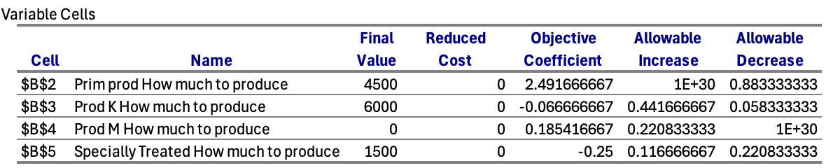
Sensitivity Analysis

Slide 7
Final thoughts
Increase the amount of raw materials available
Don’t get rid of product K

